Slide 1
Portfolio Overview
Whitney Beem
7/12/12
Instructional Technology
Kennesaw State University

Slide 2
Reading Endorsement
Reasons I chose reading:
To strengthen my knowledge of reading in the content area
To gain an additional area of certification
What I gained:
A deeper understanding of how to incorporate reading strategies in all subjects
The ability to administer a multitude of reading assessments to help diagnose reading strengths and weaknesses
The ability to plan an effective reading program to help students increase their comprehension and fluency

Slide 3
Vision
Before starting my Instructional Technology masters:
Technology should be used often to gain student attention.
After I finished my Instructional Technology masters:
Technology should be used to enhance and support the standards.
Technology cannot be thrust upon teachers, but needs to be slowly integrated into their different teaching styles.
Creating engaging lessons by using technology so students can experience the content in a different ways that best suits their learning styles is the best way to use technology to gain student attention.

Slide 4
Diversity
Modeling and advocating for the use of technology for authentic, higher order, differentiated tasks
Created engaging projects that promoted differentiation
Helped teachers create activities that can better reach students regardless of ability, ethnicity, language, socio-economic status, or age.
Identifying and addressing the unique needs of all students who have limited technology skills
Developed a plan to support and increase technology skills through practice and support for students and teachers regardless of their skills
Having weekly, informal dialogues with teachers about the use of technology associated with differentiated tasks
Discussed how the needs of special education students, English language learners, and advance students could benefit from differentiated tasks while encouraging everyone's uniqueness.

Slide 5
Standard 1
1.2 Strategic Planning – SWOT and Action Plan
Mastery:
It shows how I evaluated the current reality of the school and then followed it up with creating an action plan to tackle the needs of the school, which were based off a survey delivered to the staff to identify where they see a need.
Learned:
How to effectively manage the daunting task of completing a strategic plan by looking at a school from an objective viewpoint.
To improve upon this artifact, I would include more teacher feedback, by making the survey questions into Likert scales so it would provide more detail as to which technology they felt was the most important to learn..
Impact
Impacts the school and the faculty by identify the strengths and weaknesses of technology within the school. This important, because having an accurate analysis will help the school administration recognize where their teachers excel and where they need more help. This impact can be assessed by doing a follow up SWOT analysis and surveys to the staff.

Slide 6
Standard 2
2.3 Authentic Learning – Engaged Learner Project
Mastery:
This project requires students to tackle a real world problem, create their own solution, and present it in a professional manner, all while implementing technology throughout the entire project. While students create working models of houses for Habitat for Humanity, they are actively engaged with science standards, technology, and a social cause. Learned:
How to create an engaging project that challenges students to learn and progress with the standards while simultaneously creating an environment where the students feel like they are doing the project for a great reason than getting a grade.
To improve upon this artifact, I would change from a blended science and language arts project to a blended science and math project, due to curriculum pacing in language arts.
Impact:
Student learning and a sense of community outreach were impacted by this artifact by having students develop a plan, see it to fruition, and solve a real world need. This can be assessed through the student created presentations and debriefing after the creation of the group projects to see if the students learned both science and a sense of compassion for those who need help.

Slide 7
Standard 3
3.4 Adaptive and Assistive Technology – Individualized Student Literacy Plan
Mastery:
All of these artifacts demonstrate how technology can be used to assist and support the different needs of students by showing how technology was effectively embedded in a lesson.
Learned:
How to apply the lessons and make needed changes as issues occurred or as LB voiced her needs. I was able to find activities that she found engaging while strengthening her reading skills with a variety of technologies that she enjoyed outside of reading.
The change I would make would involve using more technology. I think LB would have benefited from reading the book electronically because she became focused on how many pages to read instead of what she was reading. Using an electronic book would make it harder for her to constantly flip forward to see the end of the chapter and would force her to focus on the page.
Impact:
Student learning was impacted with these lesson plans by helping to increase LB's reading comprehension and fluency. This was assessed through informal running records, using pre, and post-test data.

Slide 8
Standard 4
4.2 Safe, Healthy, Legal & Ethical Use - Cyber Safety Presentation
Mastery:
This artifact clearly demonstrates the safe, healthy, legal and ethical use element, through its explanations of the dangers the Internet holds and how to make sure students stay safe and do not plagiarize.
Learned:
How to protect and guide students in the safe practice with the Internet and Internet searches.
To change this artifact, I would add more information about cyber bullying and how to prevent it.
Impact:
Impacts school improvement, faculty development, and student learning by helping to create a safe and healthy environment for anyone who walks into the school. The impact can be assessed by quizzing both the teachers and students on the perils of the Internet and how to prevent making poor choices.

Slide 9
Standard 5
5.1 Needs Assessment – SWOT and Action Plan
Mastery:
This artifact shows mastery of the needs assessment element because the SWOT analysis identifies the strengths and weaknesses of the school and follows it up with an action plan that uses technology to build up the weaknesses into strengths.
Learned:
About looking at a school in whole and then slowly break it down to see the different levels. Being able to look at the big picture and develop a plan to improve the overall quality of the school is something every technology facilitator should know how to do.
If I could change something with this artifact, I would actually implement the action plan. Due to time, the action plan was never implemented, but that does not mean the plan cannot be re-evaluated and implemented 2 years after its creation.
Impact:
The SWOT and action plan impacts school improvement, faculty development, and student learning because it identifies what the school needs to fix, suggests a plan for faculty development, which in turn improves the quality of student learning. This impact can be assessed by completing another SWOT analysis to see if the weaknesses were improved upon.

Slide 10
Standard 6
6.1 Continuous Learning – Article Reviews
Mastery:
These article reviews demonstrate the continuous learning element because they show that I know how to conduct research, which allows me to gain new knowledge and be able to apply them to my beliefs and theories on education.
Learned:
How to analyze academic articles to make sure the results from the article was conducted in an appropriate manner so I could then make the educated decision to trust the results and apply them to my perceptive or decide the article lacks merit due to the testing parameters.
If I could change these artifacts, I would add to the implications sections. The articles all had a variety of implications that can apply to a variety of educational settings, but the implications I originally drew did not cover all the implications possible.
Impact:
These article reviews can impact faculty development because they show teachers best practices and provide them ideas on how to improve their classroom environments in a variety of ways. The impact can be assessed by talking with the teachers who read the article reviews to find out if they made any changes to their educational practices.

Slide 11
Reflection
Knowledge
Communication
Differentiation with technology
Skills
Analyzing educational articles
Analyzing and implementing needs assessment and professional learning program
Conducting User Experience research
Beliefs
Technology can be used by all
Positivity and a smile goes a long way
Educational research is necessary to make changes

Slide 12
Function of Classroom Websites
Whitney Beem
7/12/12
Instructional Technology
Kennesaw State University

Slide 13
Problem
With communication starting to be primarily centered on the Internet, teachers are starting to use their classroom websites as a communication tool with parents and students. However, with this new communication tool, teachers are not aware of how their classroom websites are being used by parents and students.

Slide 14
Plan and Evaluation
Tasks
Surveying parents on what they want from classroom websites
Surveying teachers on how they use classroom websites
Conducting research in educational journals on communication in education and User Experience (UX) research on websites
Conducting UX on different types of classroom websites based on the surveys and literature review
Write a research article examining the results from the UX research
Create a Teacher Tube video explaining the research and how it can be implemented in the classroom
Deliverables
Data analysis based on both parent and teacher surveys on their wants from classroom websites
Literature review on communication and UX research on websites
Data from UX presented in appropriate tabular and graphical representations based on populations including a variety of open ended response quotes,
Research article examining the results and implication of the UX research
10 minute video will be uploaded to Teacher Tube explaining the results of our research and how teachers can implement/change their classroom websites to be more effective.

Slide 15
Classroom Expectation Survey
The purpose of this survey is to gather opinions of parents/teachers on the uses of classroom websites. It will take approximately 3 minutes to complete. When finished, please click the submit button at the bottom of the page to ensure your answers are recorded.

Slide 16
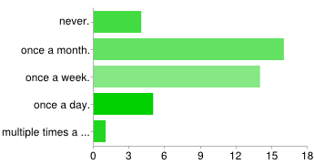
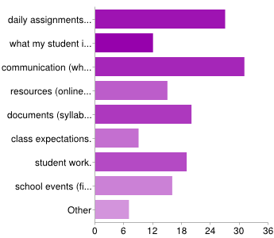
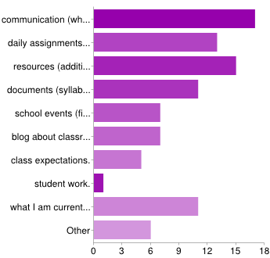
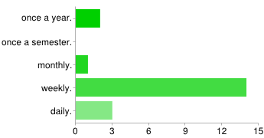
Classroom Expectation Survey Results
Parents
I go to teacher websites
I go to teacher websites to look for
Teachers
I update my class website
The content on my website includes

Slide 17
UX Research Part 1
For the first part of this research project, you will view screen shots of different classroom website layouts. You will get 15 seconds for each screen shot of each website’s home page. During that time please take note of any aspects of the layout you like, any aspects you do not like, and the overall functionality of the classroom website. You will not be able to interact with the websites, only look. All names, faces, and schools have been blocked out for privacy. After 15 seconds, the next screen shot will automatically appear. After viewing all the screen shots, a survey will be given to gather your overall opinions.

Slide 18
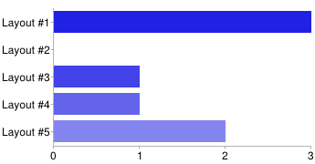
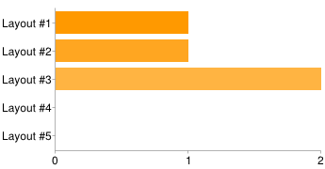
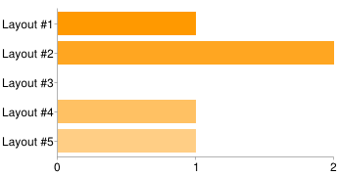
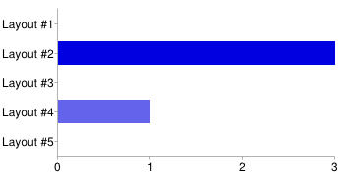
UX Research Part 1 Results
As a parent, I would prefer to use the classroom website with
As a parent, I would NOT prefer to use the classroom website with
As a teacher, I would prefer to use the classroom website with
As a teacher, I would NOT prefer to use the classroom website with

Slide 19
UX Research Part 2
For the second part of this research project, you will have four different tasks to complete. For each task, you will be asked to locate a piece of information. Each slide will have the task at the top and the website you will use to locate the information in the middle of the screen. Instead of screen shots like the first part, this part will have live websites embedded in each slide. Use your mouse like you normally would to locate the information. Once you have found the information, tell the proctor, and then click on the slide to proceed to the next task. All the tasks will relate to different formats for communicating daily assignments and homework on a classroom website. Once all four tasks have been completed, a survey will be given to gather your experience and opinion on the functionality of the website and how each communicated daily assignments and homework.

Slide 20
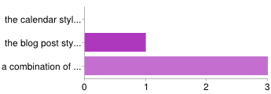
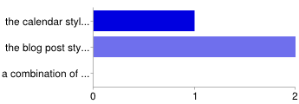
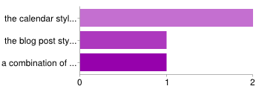
UX Research Part 2 Results
As a parent, I would prefer to use the classroom website with
As a parent, I would NOT prefer to use the classroom website with
As a teacher, I would prefer to use the classroom website with
As a teacher, I would NOT prefer to use the classroom website with

Slide 21
UX Research Part 3
For the third part of this research project, we are going to have you complete a survey on your overall experience with the first two parts of this project. Please complete the survey on the next slide to the best of your ability.

Slide 22
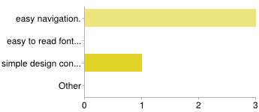
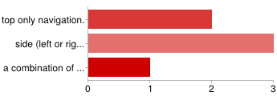
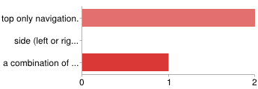
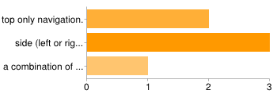
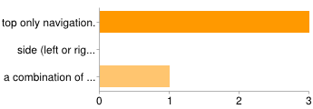
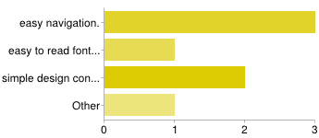
UX Research Part 3 Results
Parents
Based on today's experience, I prefer
Based on today's experience, I feel like my student(s) would best be able to navigate
Based on today's experience, I feel like the most important aspect of functionality is
Teachers
Based on today's experience, I prefer
Based on today's experience, I feel like my student(s) would best be able to navigate
Based on today's experience, I feel like the most important aspect of functionality is

Slide 23
UX Research Conclusion
Function of classroom websites depends upon the audience
Easy navigation is important to website function
Design can impact function negatively

Slide 24
Reflection
UX research can lead down many different paths, which opens the mind to a multitude of answers.
Educational research is an important aspect to creating change.
The research will continue on!

